Slide 1





Université Paris Saclay
Ecole de Technologie Supérieure
Internship Master 2 presented by Clara Martinez
Deep Learning framework leveraging Attention Transfer of Knowledge Distillation with physiological signals.
02/10/2024
Internship supervised by:
Dr. GRANGER Eric FRSQ Double Chair in AI and Digital Health
& Director of LIVIA - Systems Engineering Department at ETS
Dr. ETEMAD Ali Researcher at Queen’s University – Faculty, Ingenuity Labs
Internship advised by:
Dr. ZEHRAOUI Farida Deep Learning and Personalized Medicine Teacher at IBISC Laboratory

Slide 2

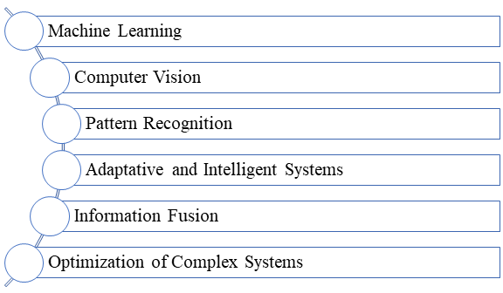
I. Strategic Context
Imaging, Vision, and Artificial Intelligence Laboratory
1/22
Notes:
The Imaging, Vision, and Artificial Intelligence Laboratory (LIVIA) at the École de Technologie Supérieure (ÉTS) is a cutting-edge research unit dedicated to advancing the field of artificial intelligence (AI) through the visual perception of 2D and 3D scenes and the static and dynamic modeling of environments. Established nearly 30 years ago, LIVIA has played a pivotal role in the development and dissemination of innovative AI technologies. Thus, ÉTS, with the contributions of LIVIA, ranks 6th in Canada for computer vision according to CSRankings, reflecting the laboratory’s prominent role in advancing AI research. LIVIA’s research activities are oriented around several core areas: machine learning, computer vision, pattern recognition, adaptive and intelligent systems, information fusion, and the optimization of complex systems. The laboratory is renowned for its excellence in AI engineering, particularly in developing complex models for deep learning that can handle massive amounts of data with limited annotations. This focus is crucial for applications that require precise and accurate interpretations of vast datasets, such as medical imaging and surveillance systems.

Slide 3
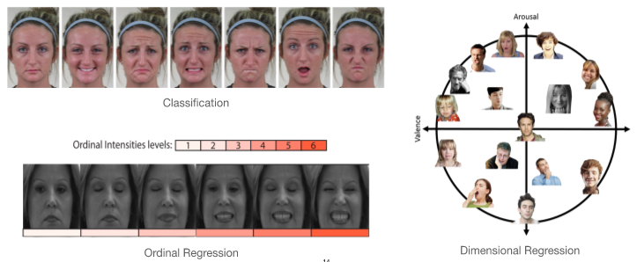
Internship’s Scientific Context
Expression Recognition
Affective Computing
Importance of automated expression recognition
Predict a subject’s affective state in health diagnosis and monitoring
Estimating non-verbal cues to personalize eHealth interventions in a behavior change program
Source: Du, et al., “Compound facial expressions of emotion,” Proc. National Academy of Sciences, 2014.
2/22
Notes:
Humans are known for their strong emotional expressions.​
Facial expressions are a key component of human emotional communication.​
Recognition of facial expression has a great commercially value.​
Expression recognition is the fundamental problem of affective computing and can take several forms​. _ Predict a subject’s affective state in health diagnosis and monitoring​
Estimating non-verbal cues to personalize eHealth interventions in a behavior change program​
Designing systems for the spontaneous recognition of facial and vocal expressions. E.g. Ambivalence​
Having mixed or contradictory feelings towards something​
Crucial for behavior change interventions in eHealth​
Contradictions can also be observed across modalities​
Ambivalence in language/text modality​
Train multidisciplinary specialists in behavioral medicine and AI​
​

Slide 4
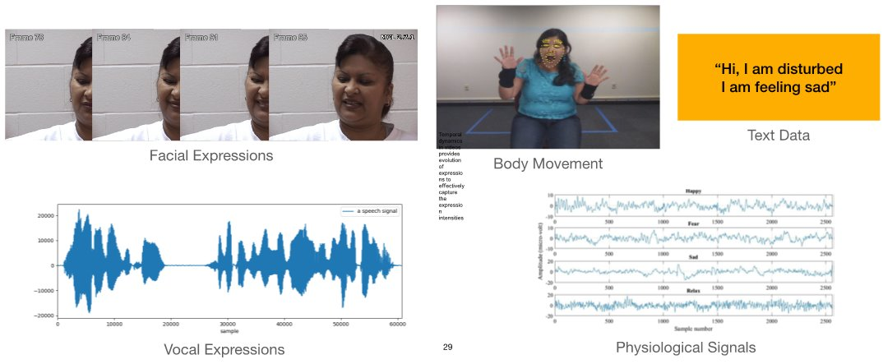
Modalities
Source: 2013 6th International Conference on Human System Interactions (HSI)
3/22

Slide 5
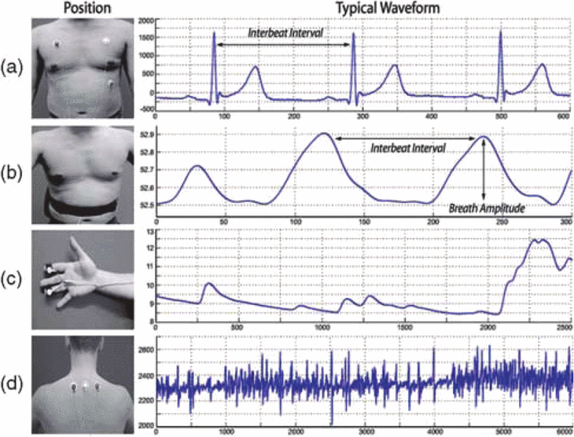
Physiological signals
ECG
BVP : Blood volume pulse​​
EDA : Electrodermal activity​​
EEG : Electroencephalogram​​
ECG : Electrocardiogram​​
EMG : Electromyogram​​
HEOG : Electrooculogram​​
MEG : Magnetoencephalogram​​
NIR : Near-infra-red​​
RESP : Respiration​​
sEMG : Surface Electromyography
TEMP : Skin temperature​​
tEMG : Trapezius-electromyogram
RSP
SC
SC
EMG
Source: Wioleta, S. . Using physiological signals for emotion recognition. 2013 6th International Conference on Human System Interactions (HSI). IEEE. doi: 10.1109/HSI.2013.6577880).
4/22

Slide 6

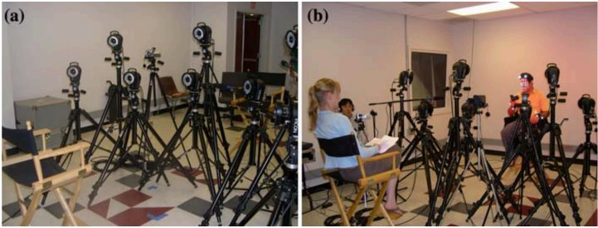
Objectives
Develop cost-effective Deep Learning models for AER using multimodalities
Challenges
Enhance diagnosis and treatment in the medical field
Variability of biological data across different individuals and capture conditions
Limited dataset in health (public, high-cost, label ambiguity)
Fusion of multimodality
pain (left) vs. no pain (right) frames
Source: Li, S., Deng, W. and Du, J., 2017. Reliable crowdsourcing and deep locality-preserving learning for expression recognition in the wild. In Proceedings of the IEEE conference on computer vision and pattern recognition (pp. 2852-2861).
5/22
Notes:
Variability of facial and vocal expressions captured in videos, and across different individuals and capture conditions (sensors, devices, and environments)​
Shift in distributions between the design (source) and operational (target) datasets​
Real-world capture: occlusion, pose, illumination, complex background, noise​
State-of-art deep learning (DL) models are complex and require large datasets for end-to-end training​
Few relevant public datasets are available in health​
High cost of collecting and annotating large-scale datasets that contain controlled expressions​
Label ambiguity from annotators​

Slide 7
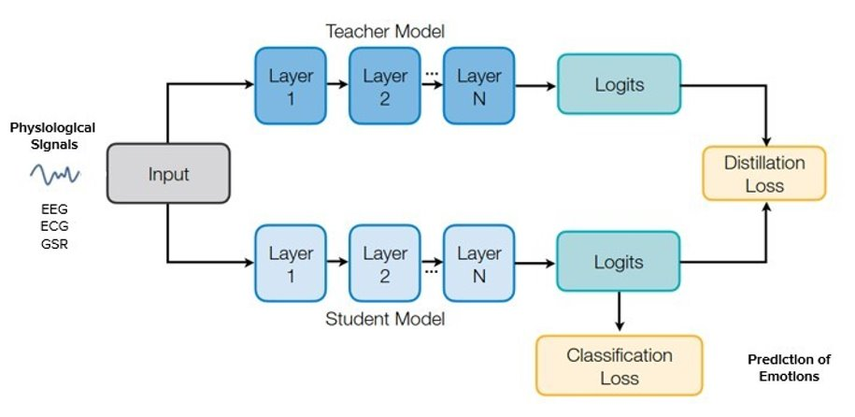

Knowledge distillation
Train multimodalities
Handel high-dimensional and complex data
Perform with limited annotated data
Model compression
E-Health Applications
Source: Ojha, U., Li, Y., Sundara Rajan, A., Liang, Y., & Lee, Y. J. (2023). What Knowledge Gets Distilled in Knowledge Distillation? Advances in Neural Information Processing Systems, 36, 11037–11048.
6/22
Notes:
This method facilitates the transfer of knowledge from a complex, over-parameterized model (teacher) to a simpler, more efficient model (student), thereby achieving model compression and enhancing performance on edge devices. KD also improves learning in scenarios with limited labeled data by leveraging the knowledge acquired from large, well-labeled datasets.
Limited computational power = wearable devices

Slide 8
Theoretical Framework
Review of the databases
And existing models
BioVid Heat Pain Database
Emopain-2021
StressID
WESAD
MAHNOB-HCI
DREAMER
DEAP
AMIGOS
SEED
LUMED
DECAF
ASCERTAIN
Article | Model | Modal | Method | Dataset | Application
Sarkar, Pritam, and Ali Etemad. ‘XKD: Cross-Modal Knowledge Distillation with Domain Alignment for Video Representation Learning’. arXiv, 24 December 2023. http://arxiv.org/abs/2211.13929 | XKD | Audio + Video | Self-supervised Novel alignment strategy | AudioSet Kinetics400 Kinetics-Sound UCF101 HMDB51 ESC50 FSD50K | Video action recognition, sound classification, and multimodal fusion.
Hajavi, A., & Etemad, A. (2023). Audio Representation Learning by Distilling Video as Privileged Information. arXiv, 2302.02845. Retrieved from https://arxiv.org/abs/2302.02845v1 | LUPI | Audio + Video | Learning using privileged information | RAVDESS, IEMOCAP | Speaker recognition and speech emotion recognition
Aslam, M. H., Zeeshan, M. O., Belharbi, S., Pedersoli, M., Koerich, A., Bacon, S., & Granger, E. (2024). Distilling Privileged Multimodal Information for Expression Recognition using Optimal Transport. arXiv, 2401.15489. Retrieved from https://arxiv.org/abs/2401.15489v1 | PKDOT (Privileged Knowledge Distillation with Optimal Transport) | Audio + Video | Learning using privileged information | Biovid, Affwild2 | Pain estimation, arousal-valence prediction
6/22

Slide 9
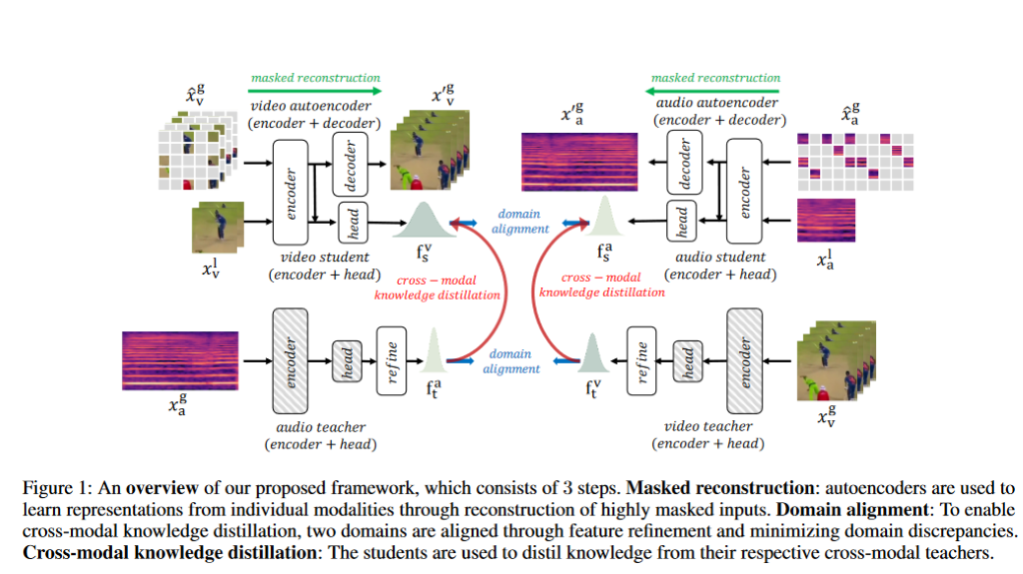
Masked data modelling
XKD employs autoencoders to learn modality-specific representations through masked data reconstruction.
Autoencoders, comprising an encoder and a decoder, are trained to reconstruct masked inputs from both audio and visual streams.
By reconstructing highly masked inputs, the autoencoders capture essential modality-specific information, facilitating downstream tasks.
XKD
2. Multimodal Knowledge Distillation
XKD adopts a teacher-student setup to distill and transfer knowledge between audio and visual modalities.
The teachers, comprised of a backbone and a projector head, provide supervision to the students.
To enable effective knowledge transfer, XKD introduces a domain alignment strategy, minimizing domain gaps and identifying transferable features between modalities.
Source: Sarkar, Pritam, and Ali Etemad. ‘XKD: Cross-Modal Knowledge Distillation with Domain Alignment for Video Representation Learning’. arXiv, 24 December 2023.

Slide 10
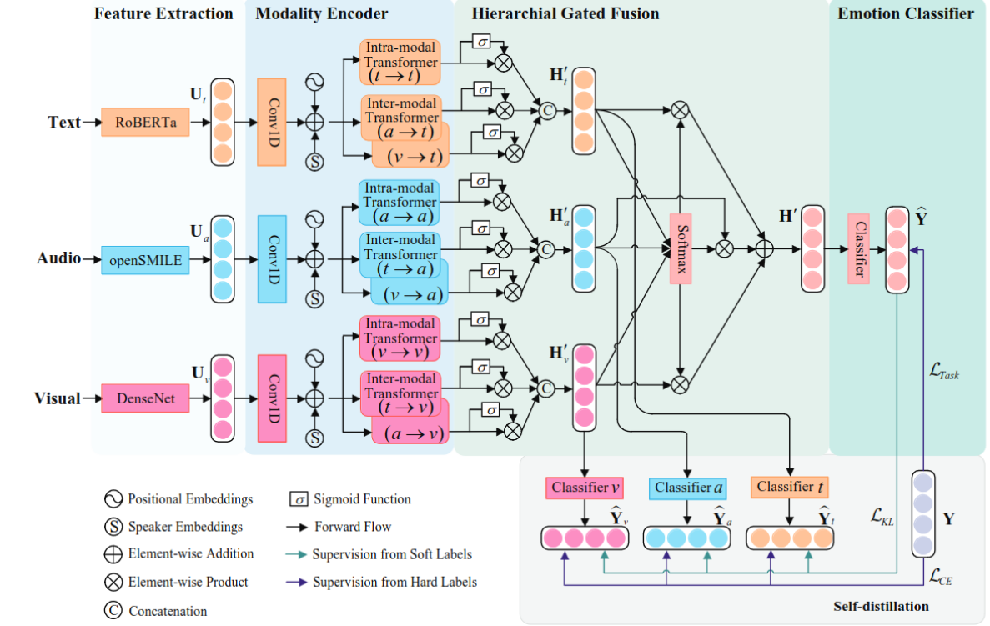
1.Modality Encoder: Captures intra- and inter-modal interactions. Utilizes temporal convolution, positional embeddings, and speaker embeddings to augment sequence representations. Employs intra- and inter-modal transformers to model interactions within and between modalities.
2. Hierarchical Gated Fusion: Dynamically learns weights between modalities : Contains unimodal- and multimodal-level gated fusions to obtain enhanced single-modality representations and learn weights between them
3. Emotion Classifier: Predicts emotion labels. Utilizes an FC and softmax layer to calculate probabilities over emotion categories. Task loss is estimated using cross-entropy loss during training.
4. Self-distillation Transfers knowledge from hard and soft labels to each modality through three student models. Employs cross-entropy loss and KL divergence loss during training.
SDT
Source: Ma, H., Wang, J., Lin, H., Zhang, B., Zhang, Y., & Xu, B. (2023). A Transformer-Based Model With Self-Distillation for Multimodal Emotion Recognition in Conversations. IEEE Trans. Multimedia, 1–13. doi: 10.1109/TMM.2023.3271019

Slide 11
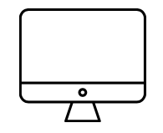
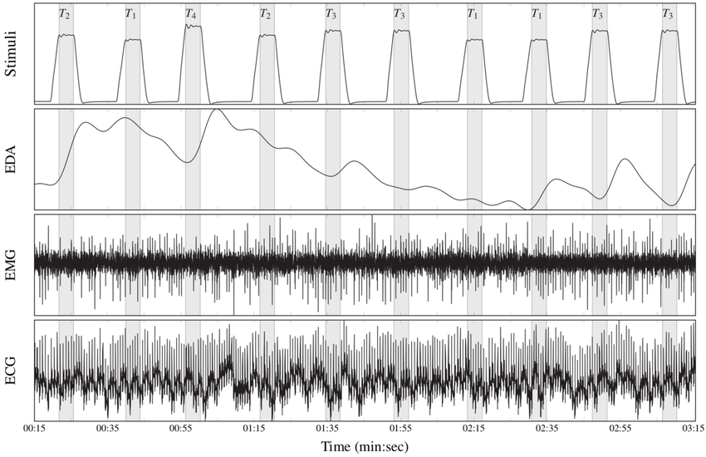
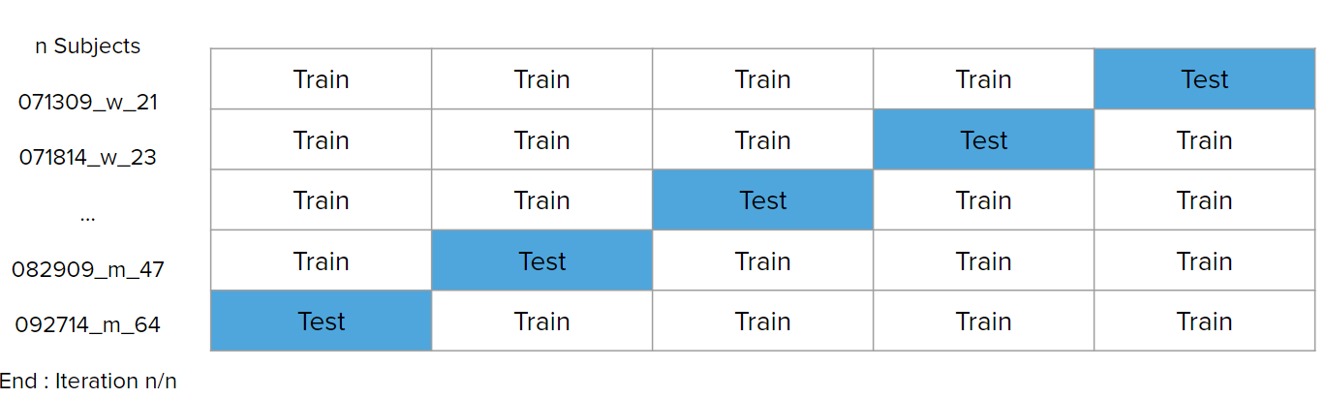
II. Project Outline
Visual Studio Code ( version 1.74.2)
Python ( version 3.10.6)
BioViD Database
Pain Simulation
Samples: 8700 from 87 subjects
Classes: 5, with 20 samples per class per subject
Time Windows: 5.5 seconds
Leave-One-Out Cross-Validation
Source: Thiam, P., Hihn, H., Braun, D. A., Kestler, H. A., & Schwenker, F. (2021). Multi-Modal Pain Intensity Assessment Based on Physiological Signals: A Deep Learning Perspective. Frontiers in Physiology, 12.
7/22
Notes:
Electrodermal Activity (EDA): Captures changes in skin conductivity, associated with sweat gland activity and emotional arousal. Surface Electromyography (sEMG): Measures muscle activity at the skin's surface, particularly useful for detecting muscle tension and facial expressions.
ECG monitors heart rate and heart rate variability (HRV), which are crucial for assessing autonomic nervous system activity.
Leave-One-Out Cross-Validation (LOSO) is a cross-validation procedure, in which for each cluster, the data set is partitioned in such a way that the model on which any given instance is tested has been trained on data that excludes the data from one subject, in contrast to traditional K-fold cross-validation. By implementing these cross-validation techniques, we aim to ensure the robustness and reliability of our machine learning models, providing a comprehensive evaluation framework that mimics real-world scenarios and addresses potential biases in model training and testing.

Slide 12
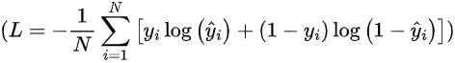
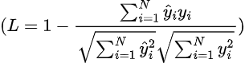
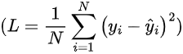
Cost Functions
Cross-Entropy Loss
Cosine Similarity Loss
MSE Loss
Distillation Loss
8/22
Notes:
Cross entropy loss : Mainly used for binary and multiclass classification.
Measures the difference between the predicted probability distributions and the actual distributions. where 𝑦𝑖 is the actual value, 𝑦𝑖 is the predicted probability, and 𝑁 is the number of examples.
Mean Squared Error (MSE) for regression
Measures the average squared difference between the actual and predicted values. where 𝑦𝑖 is the actual value, 𝑦𝑖 is the predicted probability Cosine Similarity Loss For Neural Networks and Advanced Techniques
Used in tasks where the angle between the prediction vectors and the ground truth vectors is important.
For Learning with Knowledge Distillation
Distillation Loss : Combines the loss between the teacher's and student's outputs and the loss between the student's predictions and the ground truth. LCE is the cross-entropy loss and 𝐿KD is the knowledge distillation loss.

Slide 13
Pseudo-algorithm
Input : Dataset D consisting of n (=87) subjects of GSR signals, Model parameters
Perform Leave-One-Out Cross-Validation (LOOCV) :
For each subject i in the remaining dataset:
- Let Dtrain i denote the dataset with subject i removed
- Let Dtest i denote the data for subject i
For each replication j = 1 to k:
1) Train the model on Dtrain i until 100 epochs: Mj = Train( Dtrain i , parameters, n )
2) Validate the model on Dvalidation i : Accj = Evaluate( Mj , Dvalidation i )
3) Select the model with the highest validation accuracy: Mi* = argmax( Accj )
4) Evaluate the selected model on Dtest i : Acctest i = Evaluate( Mi* , Dtest i )
5) Compute the average accuracy over all subjects: AVGAcc = (1/n) *Σ(Acctesti )
Average accuracy over all LOOCV iterations ( AVGAcc )
9/22

Slide 14
In this algorithm:
Dtrain i represents the training dataset with subject i removed.
Dtest i represents the test data for subject i.
Dvalidation i is the validation set, which consists only of the data for subject 𝑖.
Mj denotes the model trained in the j-th replication.
Accj denotes the validation accuracy of the model in the j-th replication.
Mi* represents the selected model for subject i, chosen based on the highest validation accuracy.
Acctest i denotes the accuracy of the selected model when evaluated on the test data for subject i.
AVGAcc represents the average accuracy over all subjects in the LOOCV process.

Slide 15
Preprocessing
Noise reduction: A Savitzky-Golay filter is applied to the GSR signal for smoothing and noise reduction.
This filter reduces the high-frequency noise while preserving the original signal shape.
Baseline Wander Removal:A high-pass Butterworth filter is applied to remove baseline wander and other low-frequency noise components from the GSR signal. The filter has a cutoff frequency of 0.5 Hz and a sampling frequency (fs) of 1000 Hz.
Normalization: User-specific z-score normalization was applied to standardize signal amplitudes, minimizing inter-subject variability by centering and scaling the data for consistent model input.
Source :
Acharya, U. R., Fujita, H., Lih, O. S., Hagiwara, Y., Tan, J. H., & Adam, M. (2017). Automated detection of arrhythmias using different intervals of tachycardia ECG segments with convolutional neural network. Information Sciences, 405, 81-90.
Hannun, A. Y., Rajpurkar, P., Haghpanahi, M., Tison, G. H., Bourn, C., Turakhia, M. P., & Ng, A. Y. (2019). Cardiologist-level arrhythmia detection and classification in ambulatory electrocardiograms using a deep neural network. Nature Medicine, 25(1), 65-69.
Kiranyaz, S., Ince, T., & Gabbouj, M. (2015). Real-time patient-specific ECG classification by 1-D convolutional neural networks. IEEE Transactions on Biomedical Engineering, 63(3), 664-675.
Loni, M., et al., Deep Maker: A multi-objective optimization framework for deep neural networks in embedded systems. Microprocessors and Microsystems, 73: p.102989(2020)
Marwa, S. R., & Shakir, M. A. (2024). Improving ECG signals classification by using deep learning techniques: A review. ITM Web of Conferences, 64, 01023. https://doi.org/10.1051/itmconf/20246401023
Sarkar, P., & Etemad, A. (2020). Self-supervised ECG representation learning for emotion recognition. IEEE Transactions on Affective Computing, 13(3), 1541-1554.
Shashikumar, S. P., Shah, A., Li, Q., Clifford, G. D., & Nemati, S. (2018). A deep learning approach to monitoring and detecting atrial fibrillation using wearable technology. IEEE Journal of Biomedical and Health Informatics, 22(6), 1618-1626.
Ullah, A., Anwar, S. M., Bilal, M., & Mehmood, R. M. (2021). A hybrid deep CNN model for abnormal arrhythmia detection based on cardiac ECG signal. Sensors, 21(3), 951.
Xie, J., & Zhang, W. (2019). Multi-scale CNNs for ECG pattern detection. IEEE Journal of Biomedical and Health Informatics, 24(5), 1325-1336.
Yildirim, O., Baloglu, U. B., Tan, R. S., Ciaccio, E. J., & Acharya, U. R. (2018). A new approach for arrhythmia classification using deep coded features and LSTM networks. Computer Methods and Programs in Biomedicine, 147, 213-223.
Zhang, W., Chen, J., & Ma, T. (2019). LSTM-based analysis and prediction of driving fatigue states using ECG data. IEEE Transactions on Human-Machine Systems, 50(3), 182-193.
10/22

Slide 16
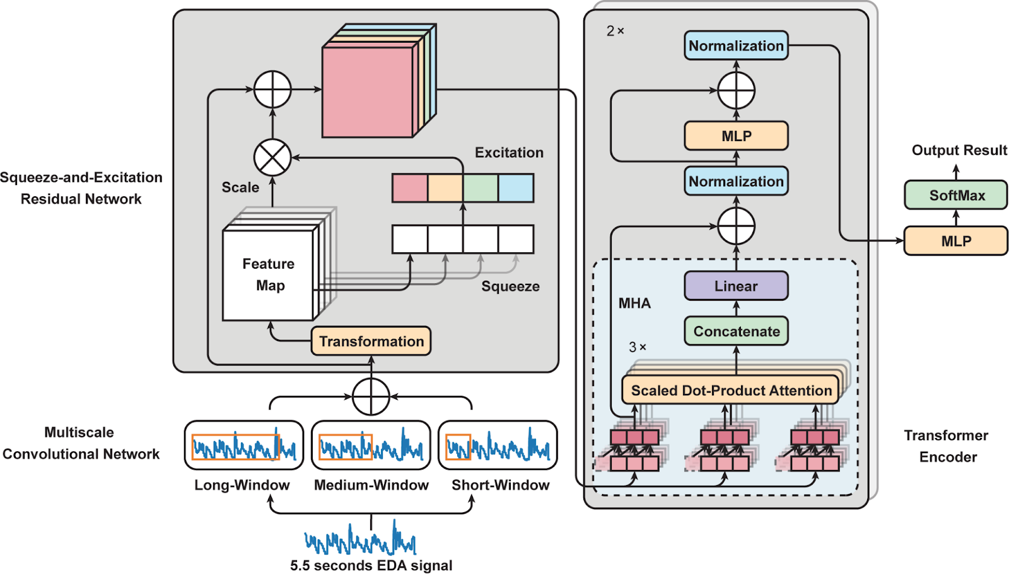
PAN
EDA
Source: Thiam . Lu, Z., Ozek, B., & Kamarthi, S. (2023) Transformer Encoder with Multiscale Deep Learning for Pain Classification Using Physiological Signals
11/22
Notes:
Multiscale convolutional networks (MSCN)
Convolutional layers and max-pooling techniques to extract information on variations in the EDA signals
Squeeze-and-excitation residual networks (SEResNet)
To learn interdependencies among features and compressing spatial information and adaptively recalibrating feature maps
To ensures that the most informative features are highlighted
Transformer encoder block
To extract features and capture temporal dependencies from physiological signals
Temporal convolutional networks (TCN)
1D-CNN to capture temporal dependencies in sequential data
Multi-head attention (MHA)
Transformer encoder block : facilitates learning long-term relationships in sequences of features by attending different part of the input sequence simultaneously

Slide 17
MSCN
PAN
SEResNet
Transformer/
Encoder block
MLP
Softmax
Outputs
Teacher
EDA
Physiological signals
at_loss
ce_loss
Student
12/22

Slide 18
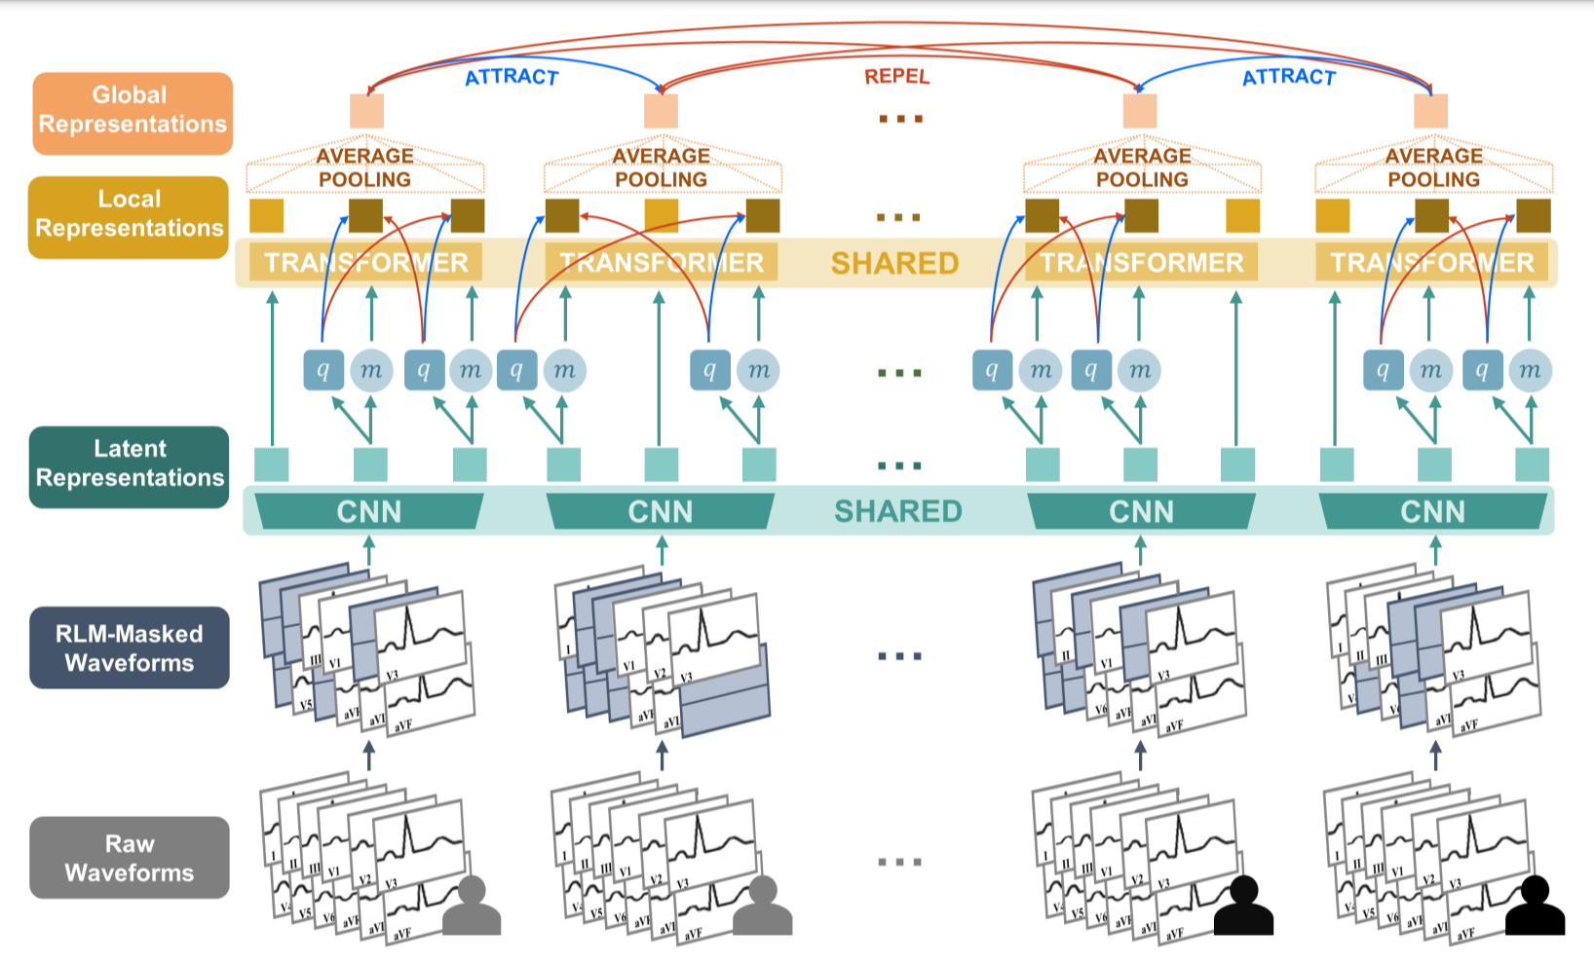
FC
ECG
Source: McKeen, K., Oliva, L., Masood, S., Toma, A., Rubin, B., & Wang, B. (2024). Ecg-fm: An open electrocardiogram foundation model. arXiv preprint arXiv:2408.05178.
13/22
Notes:
Raw waveforms are inputted, and individual leads are randomly masked. A convolutional feature encoder generates latent representations that feed into a transformer encoder, producing local representations that are then average-pooled to create global representations. Positive and negative contrastive learning pairs are depicted using blue and red arrows, respectively. In spans, latent representations are randomly masked as m and quantized to q. We then apply a local contrastive loss attracting each q to its corresponding local representation, using a subset of other q as the negative samples, or distractors. A batch of four ECG inputs, making up two positive pairs of temporally-adjacent ECG segments, are shown to visualize the CMSC global contrastive loss acting on the global representations across samples. ### 1. **Convolutional Feature Encoder**
The convolutional feature encoder is the initial part of the model responsible for extracting local, low-level features from the input ECG signals. Here’s a step-by-step breakdown of its operation:
#### 1.1. **Input Data:**
- The input consists of multiple ECG signals, each represented as a time-series segment. Typically, this input is a 1D signal representing the voltage over time for each lead of the ECG (e.g., a 5-second segment at 500 Hz results in 2500 data points per lead).
#### 1.2. **Convolutional Layers:**
- The feature encoder comprises multiple convolutional layers with a defined number of filters, kernel sizes, and strides. The purpose of these layers is to:
- **Extract Local Patterns**: Each convolutional layer captures features like QRS complexes, P waves, and T waves.
- **Reduce Dimensionality**: Through striding and pooling, the encoder reduces the temporal dimensionality, creating a compressed latent representation.
#### 1.3. **Output - Latent Representations (\(z_t\)):**
- The output of the feature encoder is a sequence of latent representations (\(z_t\)), where each \(z_t\) corresponds to a different segment of the input ECG. These representations are smaller and capture essential patterns in the input data.
### 2. **Transformer Encoder**
The transformer encoder processes the latent representations produced by the convolutional encoder to capture global context and dependencies across the entire ECG sequence.
#### 2.1. **Self-Attention Mechanism:**
- The transformer encoder uses the self-attention mechanism to compute how much focus each latent representation \(z_t\) should place on other latent representations in the sequence. This helps the model understand the dependencies between different parts of the ECG signal.
#### 2.2. **Multi-Head Attention:**
- Multiple self-attention heads allow the model to capture different types of relationships within the sequence simultaneously. For example, one head might focus on rhythm patterns, while another might focus on detecting anomalies.
#### 2.3. **Feed-Forward Network:**
- After attention is calculated, each representation is passed through a feed-forward network to further process and transform the features.
#### 2.4. **Local Representations (\(c_t\)):**
- The transformer outputs local contextualized representations (\(c_t\)) for each time step, which now incorporate both local features from the convolutional encoder and global context from the transformer.
### 3. **Average Pooling for Global Representations**
- After generating local representations (\(c_t\)) for all time steps, an average pooling operation is applied. This operation computes the mean of all local representations to create a single global representation (\(C\)), which summarizes the entire ECG segment.
### 4. **Contrastive Learning with Positive and Negative Pairs**
Contrastive learning is used to train the model by leveraging both positive (similar) and negative (dissimilar) pairs of ECG segments.
#### 4.1. **Random Masking and Quantization:**
- Random masking is applied to some parts of the latent representations (\(z_t\)), where a segment of the input is hidden, forcing the model to learn robust features.
- The masked representations are quantized to create discrete representations (\(q\)). Quantization helps in removing detailed artifacts and simplifying the target for contrastive learning.
#### 4.2. **Local Contrastive Loss:**
- For each masked token, the model tries to maximize the similarity between the quantized target \(q\) and its corresponding local representation \(c_t\). This similarity is measured using a cosine similarity metric.
- Negative samples are drawn from a set of all other masked token quantized targets (\(\tilde{q} \sim Q_t\)), representing different segments of the ECG. The model minimizes similarity with these distractors, thus learning to distinguish between similar and dissimilar representations.
#### 4.3. **Global Contrastive Loss (CMSC - Contrastive Multi-Segment Coding):**
- Positive pairs are created using temporally adjacent ECG segments, as these segments are likely to belong to the same physiological context.
- Negative pairs are created using non-adjacent segments or segments from different patients, ensuring dissimilarity.
- The CMSC objective encourages the model to produce consistent representations for positive pairs and diverse representations for negative pairs.
### 5. **Training with Batches of ECG Inputs**
During training, the model is fed batches of ECG inputs. Each batch consists of several ECG segments, and positive and negative pairs are generated dynamically:
#### 5.1. **Batch Composition:**
- A batch of four ECG segments might include two pairs of temporally-adjacent ECG segments (positive pairs) and two pairs of non-adjacent segments (negative pairs).
#### 5.2. **Loss Calculation:**
- For each segment in the batch, the contrastive loss is calculated using its positive and negative pairs. The model is optimized to reduce this loss, improving its ability to produce distinguishable representations for different types of segments.

Slide 19
MSCN
FC
Transformer
Classifier
MLP
Softmax
Outputs
Teacher
ECG
Physiological signals
at_loss
ce_loss
Student
14/22

Slide 20
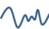
Feature maps
FUSION
Input diversity Masking
BB1
PAN EDA
Output diversity
Dropout
Teacher
512
L_{KD}
num_classes
BB2
PAN ECG
1024
NLP
512
Student
PAN EDA
15/22

Slide 21
III. Results and Perspectives
Comparison on knowledge distillation techniques : logits vs attention transfer
 |  | Evaluation T0 v T4, PAN
 |  | Modalities | Validation
 |  | EDA | 84.07
 | Teacher | ECG | 70.43
 |  | EMG corrugator | 54.69
 |  | EMG zygomaticus | 55.63
 |  | EDA | 84.07
 | Student | ECG | 99.4
Logits |  | EMG corrugator | 52.1
Attention Transfer |  | EMG zygomaticus | 51.95
 |  | EDA | 86.10
 | Student | ECG | 70.24
 |  | EMG corrugator | 77.55
Implementing Knowledge Distillation improves the prediction accuracy of pain levels.
Attention Transfer is more effective than Logits in enhancing the model's performance for pain level prediction.
16/22
Notes:
“In the provided training vs. validation accuracy curve, the x-axis represents the epochs, ranging from 0 to 100, and the y-axis represents the accuracy, ranging from 0 to 1.0. The training accuracy curve (blue) starts at approximately 0.1 and increases steadily, showing a smooth upward trend and plateauing around 0.80 after about 30 epochs.
The validation accuracy curve (orange) also starts low, at around 0.1, and increases initially. Both curves show similar behavior, indicating the model is learning well. However, after 20 epochs, the validation accuracy begins to plateau around 0.77.
From epochs 30 to 100, the validation accuracy remains relatively stable, suggesting the model maintains good generalization.
In the provided training vs. validation loss curve, the x-axis represents the epochs, ranging from 0 to 50, and the y-axis represents the loss, ranging from 0 to 1.0. The training loss curve (blue) starts at approximately 0.9 and decreases steadily, showing a smooth downward trend and plateauing around 0.1 after about 40 epochs.
The validation loss curve (orange) also starts high, at around 0.7, and decreases initially. Up to around 20 epochs, both curves show similar behavior, indicating the model is learning well. From epochs 20 to 100, the validation loss remains relatively stable, suggesting the model maintains good generalization

Slide 22
III. Results and Perspectives
Utility of pre-processing physiological signals
 |  | Evaluation T0 v T4, PAN
 |  | Modalities | Validation
 |  | EDA | 84.07
 | Teacher | ECG | 70.43
 |  | EMG corrugator | 54.69
 |  | EMG zygomaticus | 55.63
 |  | EDA | 84.07
 | Student | ECG | 65.75
Logits |  | EMG corrugator | 52.1
Attention Transfer |  | EMG zygomaticus | 51.95
 |  | EDA | 86.43
 | Student | ECG | 70.24
 |  | EMG corrugator | 77.55
Implementing Knowledge Distillation improves the prediction accuracy of pain levels.
Attention Transfer is more effective than Logits in enhancing the model's performance for pain level prediction.
ECG signals need pre-processing prior to their utilization in a DL model.
17/22
Notes:
“In the provided training vs. validation accuracy curve, the x-axis represents the epochs, ranging from 0 to 100, and the y-axis represents the accuracy, ranging from 0 to 1.0. The training accuracy curve (blue) starts at approximately 0.1 and increases steadily, showing a smooth upward trend and plateauing around 0.80 after about 30 epochs.
The validation accuracy curve (orange) also starts low, at around 0.1, and increases initially. Both curves show similar behavior, indicating the model is learning well. However, after 20 epochs, the validation accuracy begins to plateau around 0.77.
From epochs 30 to 100, the validation accuracy remains relatively stable, suggesting the model maintains good generalization.
In the provided training vs. validation loss curve, the x-axis represents the epochs, ranging from 0 to 50, and the y-axis represents the loss, ranging from 0 to 1.0. The training loss curve (blue) starts at approximately 0.9 and decreases steadily, showing a smooth downward trend and plateauing around 0.1 after about 40 epochs.
The validation loss curve (orange) also starts high, at around 0.7, and decreases initially. Up to around 20 epochs, both curves show similar behavior, indicating the model is learning well. From epochs 20 to 100, the validation loss remains relatively stable, suggesting the model maintains good generalization

Slide 23
III. Results and Perspectives
Improvement on ECG prediction signals
 | Evaluation T0 v T4, FC
 | Modalities | Validation
Teacher | ECG | 75.21
Student | ECG | 76.19
Implementing Knowledge Distillation improves the prediction accuracy of pain levels.
18/22
Notes:
“In the provided training vs. validation accuracy curve, the x-axis represents the epochs, ranging from 0 to 100, and the y-axis represents the accuracy, ranging from 0 to 1.0. The training accuracy curve (blue) starts at approximately 0.1 and increases steadily, showing a smooth upward trend and plateauing around 0.80 after about 30 epochs.
The validation accuracy curve (orange) also starts low, at around 0.1, and increases initially. Both curves show similar behavior, indicating the model is learning well. However, after 20 epochs, the validation accuracy begins to plateau around 0.77.
From epochs 30 to 100, the validation accuracy remains relatively stable, suggesting the model maintains good generalization.
In the provided training vs. validation loss curve, the x-axis represents the epochs, ranging from 0 to 50, and the y-axis represents the loss, ranging from 0 to 1.0. The training loss curve (blue) starts at approximately 0.9 and decreases steadily, showing a smooth downward trend and plateauing around 0.1 after about 40 epochs.
The validation loss curve (orange) also starts high, at around 0.7, and decreases initially. Up to around 20 epochs, both curves show similar behavior, indicating the model is learning well. From epochs 20 to 100, the validation loss remains relatively stable, suggesting the model maintains good generalization

Slide 24
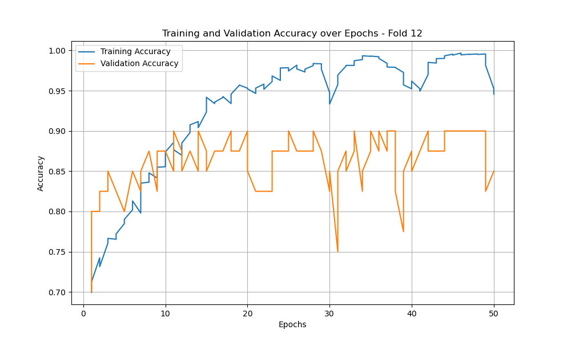
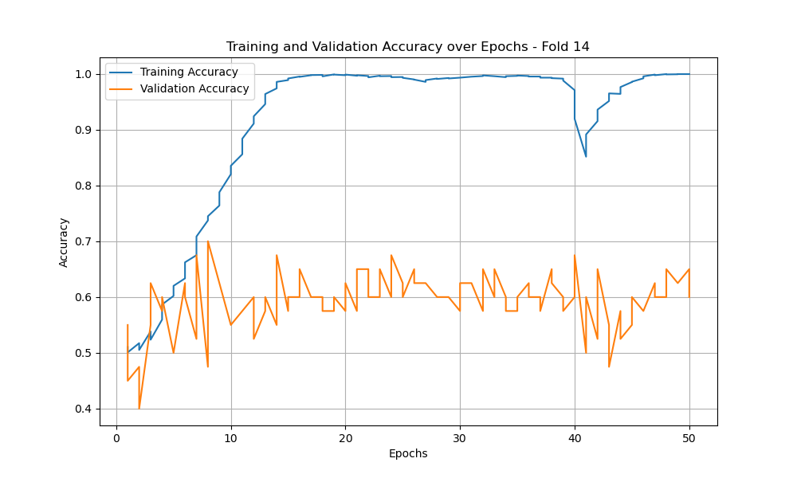
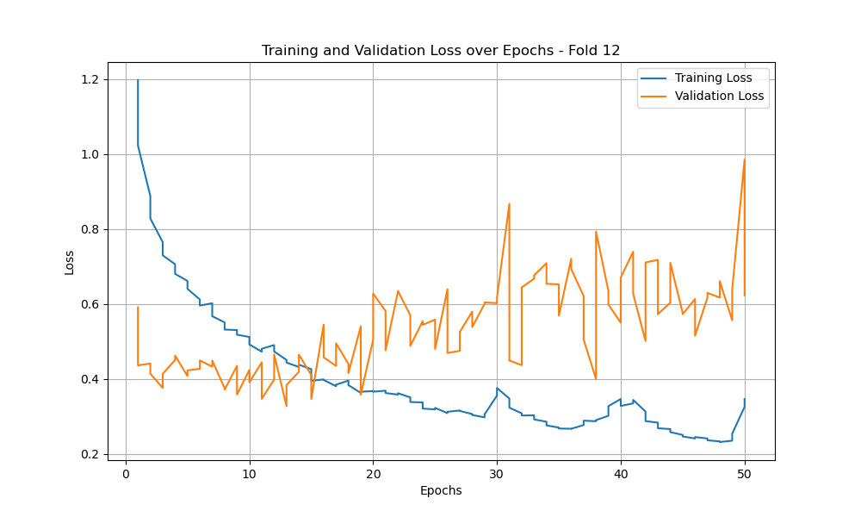
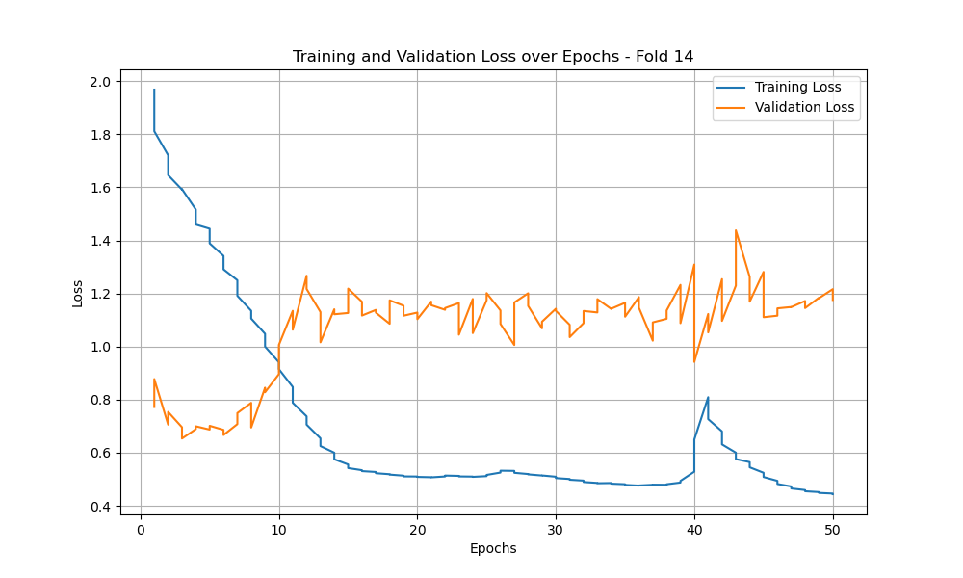
EDA PAN AT KD preprocessed
ECG PAN AT KD preprocessed

Slide 25
III. Results and Perspectives
Hyper-Parameter Tuning on EDA Teacher
 | Training | Validation
ce_loss = 0.5, at_loss = 0,5 | 79.01 | 84.07
ce_loss = 0.7, at_loss = 0,3 | 98.22 | 86.56
ce_loss = 0.3, at_loss = 0,7 | 98.22 | 86.43
ce_loss = 0.9, at_loss = 0,1 | 98.22 | 86.51
ce_loss = 0.1, at_loss = 0,9 | 98.22 | 86.43
Notes:
Attention Transfer Loss (at_loss): This loss captures the difference between the feature maps (or attention maps) of the teacher and student models. It's meant to help the student model learn which parts of the input data are most important.
Cross-Entropy Loss (ce_loss): This is the standard loss for classification tasks, comparing the student model's predictions with the true labels. It's crucial for ensuring that the student model makes accurate predictions.

Slide 26
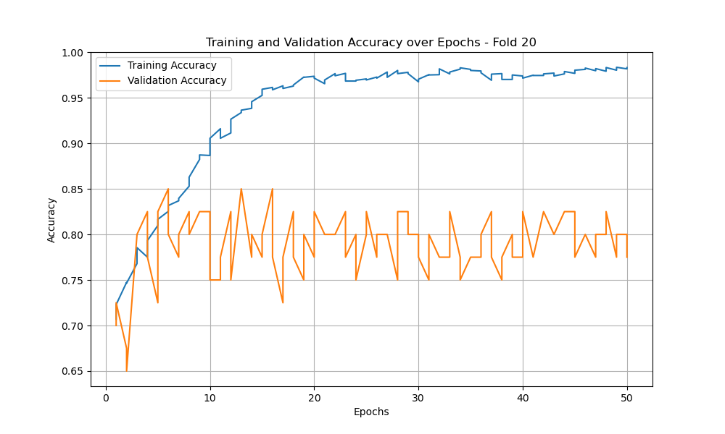
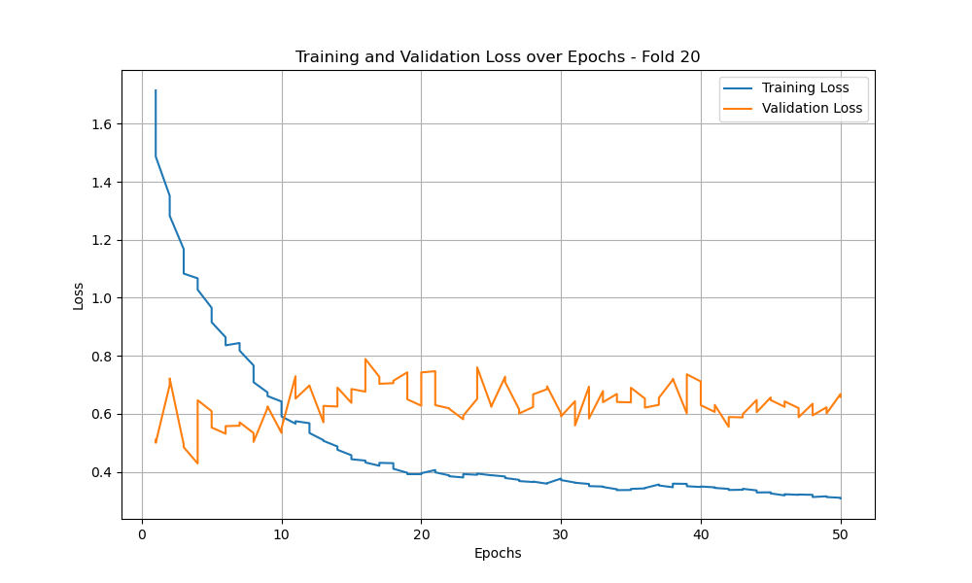
Experimenting with weights on EDA Teacher : ce_loss = 0.7, at_loss = 0,3

Slide 27
III. Results and Perspectives
Multimodality of EDA and ECG biosignals
Teacher | Student | Training | Validation
EDA | EDA | 99.56 | 86.43
ECG | ECG | 98.85 | 65.75
Fusion EDA / ECG | EDA | 97.17 | 83.08
Fusion EDA / ECG | ECG | 99.25 | 66.23
 | Modalities | Training | Validation
 | EDA | 79.16 | 84.07
Teacher | ECG | 95.52 | 65.66
 | Fusion EDA / ECG | 96.60 | 78.99
Fusion of EDA/ECG lowers prediction of pain levels.
EDA and ECG are not complementary informations.
19/22
Notes:
“In the provided training vs. validation accuracy curve, the x-axis represents the epochs, ranging from 0 to 100, and the y-axis represents the accuracy, ranging from 0 to 1.0. The training accuracy curve (blue) starts at approximately 0.1 and increases steadily, showing a smooth upward trend and plateauing around 0.80 after about 30 epochs.
The validation accuracy curve (orange) also starts low, at around 0.1, and increases initially. Both curves show similar behavior, indicating the model is learning well. However, after 20 epochs, the validation accuracy begins to plateau around 0.77.
From epochs 30 to 100, the validation accuracy remains relatively stable, suggesting the model maintains good generalization.
In the provided training vs. validation loss curve, the x-axis represents the epochs, ranging from 0 to 50, and the y-axis represents the loss, ranging from 0 to 1.0. The training loss curve (blue) starts at approximately 0.9 and decreases steadily, showing a smooth downward trend and plateauing around 0.1 after about 40 epochs.
The validation loss curve (orange) also starts high, at around 0.7, and decreases initially. Up to around 20 epochs, both curves show similar behavior, indicating the model is learning well. From epochs 20 to 100, the validation loss remains relatively stable, suggesting the model maintains good generalization

Slide 28
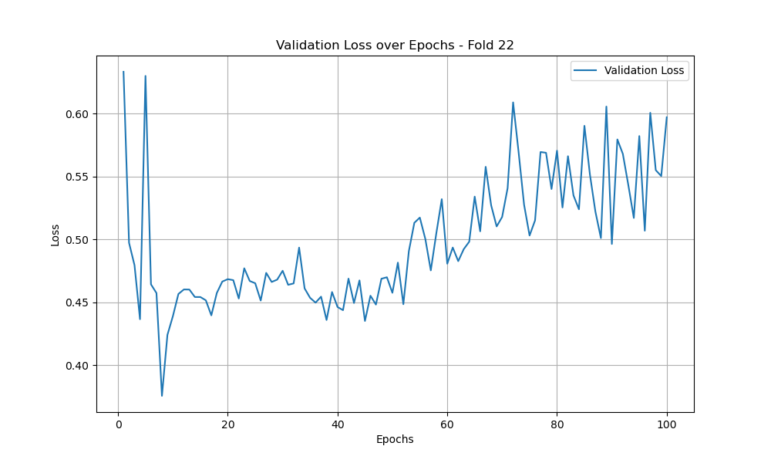
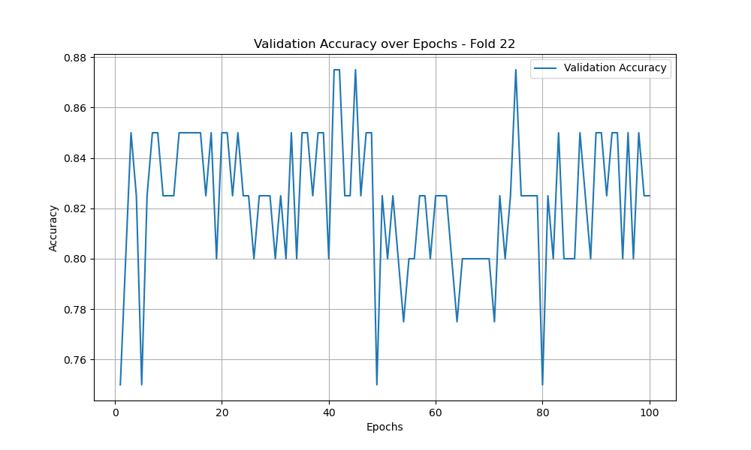
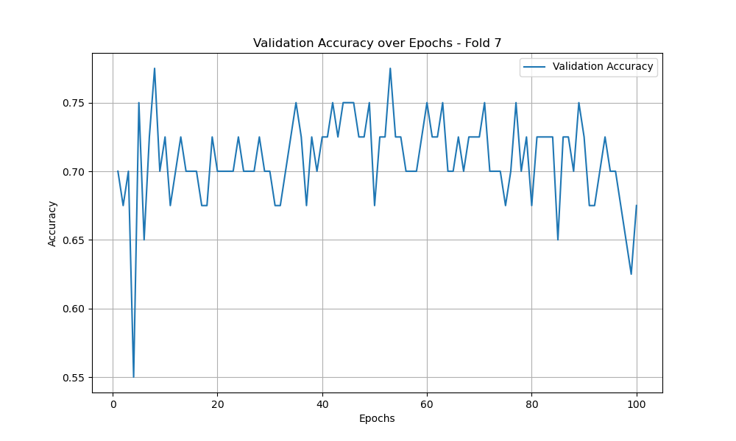
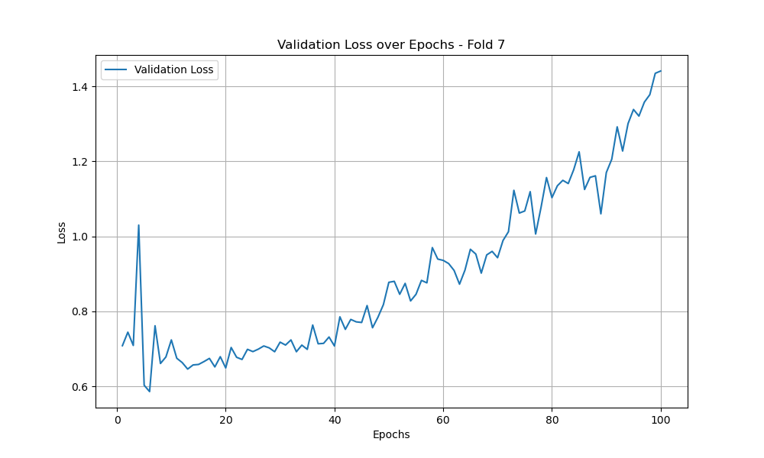
Fusion of EDA/ECG preprocessed

Slide 29
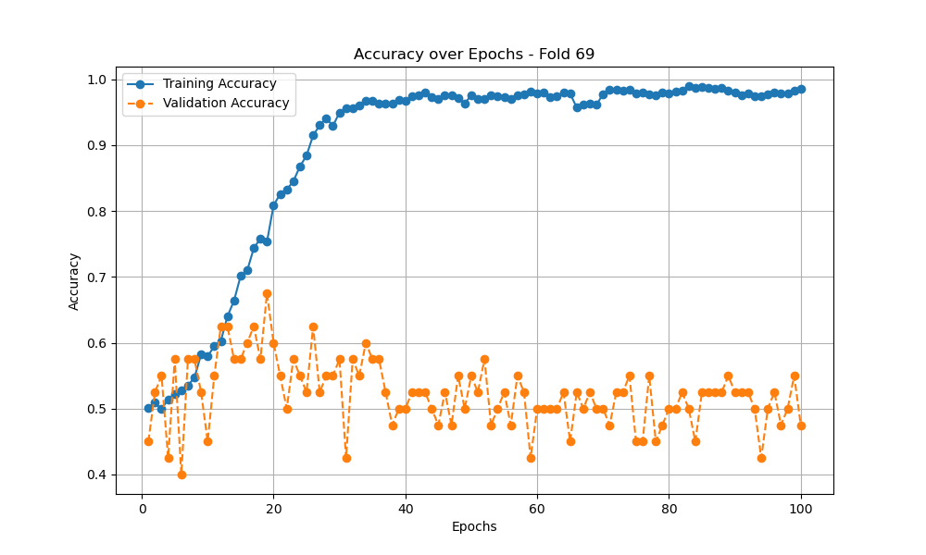
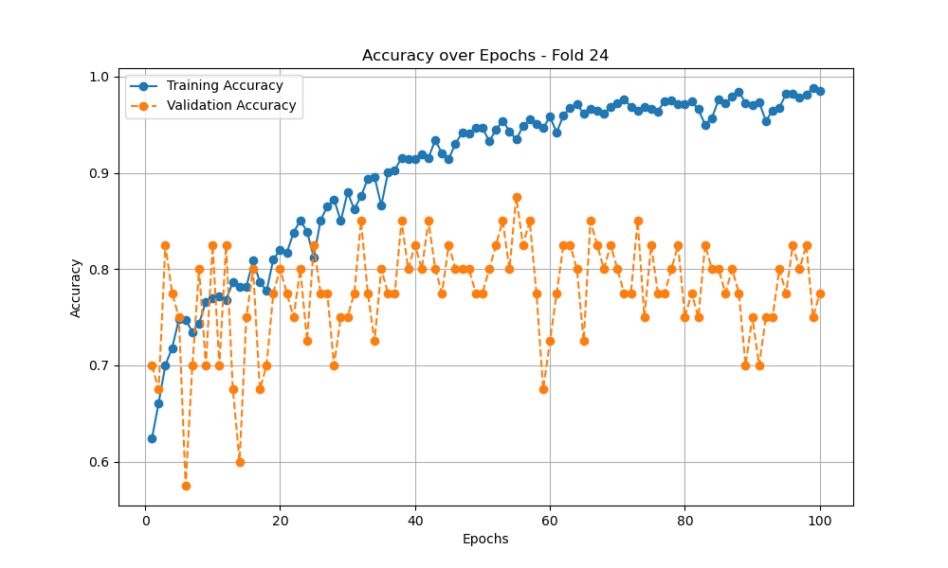
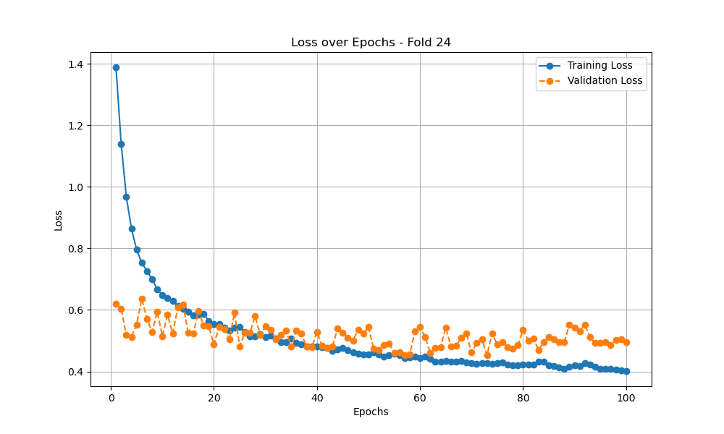
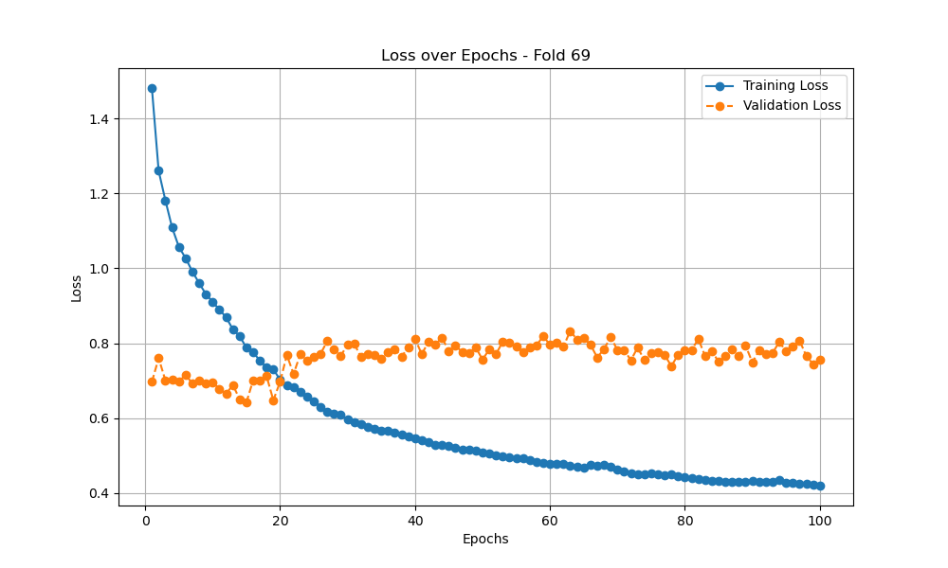
KD Fusion T: EDA/ECG S: EDA
KD Fusion T: EDA/ECG S: ECG

Slide 30
III. Results and Perspectives
Comparison with SOTA
 | Evaluation T0 v T4
Modalities | Training | Validation
Logits EDA | 79.16 | 84.07
Attention Transfer PAN EDA | 82.30 | 86.43
Attention Transfer FC ECG |  | 75.21
Fusion EDA/ECG | 96.60 | 83.08
SOTA EDA | - | 85.56
SOTA ECG |  | -
Above SOTA prediction of pain level on BioVid dataset.
Source : Lu, Z., Ozek, B., & Kamarthi, S. (2023) Transformer Encoder with Multiscale Deep Learning for Pain Classification Using Physiological Signals
20/22

Slide 31
IV. Discussion
Implementing Knowledge Distillation improves the prediction accuracy of pain levels.
Attention Transfer is more effective than Logits in enhancing the model's performance for pain level prediction.
ECG signals need pre-processing prior to their utilization in a DL model.
Fusion of EDA/ECG lowers prediction of pain levels.
EDA and ECG are not complementary informations.
Above SOTA prediction of pain level on BioVid dataset
21/22

Slide 32
Perspectives
Feature maps
FUSION
Input diversity Masking
BB1
EDA
PAN EDA
Output diversity
Dropout
Teacher
512
L_{KD}
num_classes
BB2
ECG
FM ECG
1024
NLP
512
Student
PAN EDA
22/22

